Slide 1

Developing Web Applications using Visual Studio.NET
Hassan Tariq
Notes:
Click to add notes
Peter Gfader Developing Windows and Web applications

Slide 2
Agenda
Overview of ASP.NET
An ASP.NET Page
Server Controls
Validation
Master Pages
Themes
Notes:
-- Reb: I’ve hidden this slide as it appears to be a duplicate.

Slide 3

The web

Slide 4
HTML
HyperText Markup Language
Describes a web page
http://en.wikipedia.org/wiki/HTML
<html>
<head>
<title>Hello HTML</title>
</head>
<body>
<p>Hello World!</p>
</body>
</html>

Slide 5
HTTP
Hypertext Transfer Protocol
Request – Response
http://en.wikipedia.org/wiki/Http
GET /index.html HTTP/1.1 Host: www.example.com
HTTP/1.1 200 OK
Date: Mon, 23 May 2005 22:38:34 GMT
Server: Apache/1.3.3.7 (Unix) (Red-Hat/Linux)
Last-Modified: Wed, 08 Jan 2003 23:11:55 GMT
Content-Length: 438
Content-Type: text/html; charset=UTF-8

Slide 6



How a web page is shown
Your
Computer
Hosting
Computer
Internet
The
Internet
Client
Server
Notes:
Show in Firebug → google.com

Slide 7

Request / Response
Request
www.ssw.com.au
The
Internet
Response
Client
HTML
Server
Notes:
Show in FireBug

Slide 8
What Is ASP.NET?
ASP.NET provides a complete environment for building, deploying, and running .NET Web applications.
Developer Productivity
Target any Web client (PC or mobile device)
Modular, well-factored, extensible architecture
Superior debugging and tracing support
Enhanced Performance, Scalability, and Reliability
Automatically detects and recovers from errors
Simple Deployment and Configuration
Notes:
[Note to speaker: Ask the audience if they are familiar with what ASP.NET is; if they are you can skip this slide]
Realities about Web application development:
Web technologies do not offer good programming models and often result in a mess of code that is difficult and expensive to maintain.
The final product is never as rich as a client-based (Windows) application, but users expect more and more.
Web applications have grown immensely in popularity and as a result have grown in size and complexity.
Web applications operate in an uncertain environment – they are open to hackers and have no way to be 100% certain about who the end user will be, or how many end users will attempt to use the application at once.
All of these realities drove several members of the team that developed ASP to consider an entirely new Web development platform that brought Web development closer to a Windows client development experience and allowed IT departments to build applications that were secure in the uncertain environment that is the Internet, and that offered the best experience for the end users.
ASP.NET is the .NET platform for building, deploying, and running Web Applications.
It allows developers to create rich, scalable, high performance Web applications more quickly than ever and provides a platform for enterprises to run those applications reliably and securely.
ASP.NET addresses the needs of today’s developers: high efficiency, simple yet powerful APIs, high performance, and reliability.
Developer Productivity
One of the first things customers notice when working with ASP.NET is how much it simplifies and speeds up the process of developing Web applications. ASP.NET introduces a new page development model which builds on lessons learned in the Windows client development space to create an form-based approach to Web development through a series of controls and event-based architecture.
ASP.NET takes into account the realities of modern Web development: Today’s Web developers are facing increased demand to support not just PC-based clients, but all types of new devices such as cell phones, PDAs, and advanced pagers. Until now, building Web-based applications that target these devices has been extremely challenging since the Web developer must support multiple devices different screen sizes, buttons, and markup capabilitities. Some support HMTL, WML, and cHMTL, and attempting to test every device out there is unimaginable. With the ASP.NET Mobile Controls, developers can target multiple devices from a single application. We’ll talk about that in a moment.
[It introduces the concept of server controls – blocks of code that are executed on the server, whose output is automatically targeted at any type of Web client – be it different browser types.]
ASP.NET introduces full-features compiled language support whose constructs support exception handling, attributes, and other advanced language features.
And since we know organizations and developers often have very specific needs out of their technology infrastructure, we created ASP.NET with a well factored architecture that makes it easy to extend the ASP.NET core functionality for developers who wish to build on this awesome platform.
Full debugging support – supported through our great tool Microsoft Visual Studio® .NET.
Enhanced Performance, Scalability, and Reliability
The value proposition of the Internet is that end users can access applications 24 hours a day 7 days a week. This means that applications have to be up and running constantly, be able to scale to unexpected levels of demand, and be able to recover from any faults that might occur.
Compiled, not interpreted
Rich caching support
Web farm scalable session state
Automatically detects and recovers from errors
Simple Deployment and Configuration
Web applications have grown in size and complexity
Deploy and upgrade running applications with XCOPY, App Center server (no need to bring down Web server)
XML Configuration files (store your own parameters, fine grained control over behavior of ASP.NET process, security, other parameters)
Deploying front-end and middle-tier components was very challenging with previous technologies. It Required local access to box, had to stop Web server. As applications have grown from simple single servers to large datacenters and Web farms, this problem has grown exponentially.

Slide 9
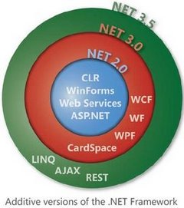
.NET Framework
Evolution
The whole .NET FX
http://shrinkster.com/1515
Notes:
http://download.microsoft.com/download/4/a/3/4a3c7c55-84ab-4588-84a4-f96424a7d82d/NET35_Namespaces_Poster_LORES.pdf

Slide 10
2 Types of Projects – 1 – Web Site
Web Site
Don’t use this, here for compatibility only
File > New > Web Site
Each page is dynamically loaded into memory
Slow on first load after deployment
No need to recompile for code change

Slide 11
2 Types of Projects – 2 – Web Application
Web Application -
Recommended
File > New > Projects, then Select Web Application
Compiles all pages into one DLL
Faster on first load after deployment
Must recompile whole site for code change
Not available in Default VS 2005, requires SP2

Slide 12

The Page

Slide 13
ASP.NET –Page/Web Form
An ASP.NET Web page consists of two parts:
Visual elements, which include markup, server controls, and static text.
Programming logic for the page, which includes event handlers and other code.
Notes:
File new project

Slide 14

A Page's Life

Slide 15
ASP.NET – Page Life Cycle Stages
Page request
Start
Page Initialization
Load
Validation
Postback Event handling
Rendering
Unload
http://msdn.microsoft.com/en-us/library/ms178472.aspx
Notes:
Stage Description
Page request
The page request occurs before the page life cycle begins. When the page is requested by a user, ASP.NET determines whether the page needs to be parsed and compiled (therefore beginning the life of a page), or whether a cached version of the page can be sent in response without running the page.
Start
In the start step, page properties such as Request and Response are set. At this stage, the page also determines whether the request is a postback or a new request and sets the IsPostBack property. Additionally, during the start step, the page's UICulture property is set.
Page initialization
During page initialization, controls on the page are available and each control's UniqueID property is set. Any themes are also applied to the page. If the current request is a postback, the postback data has not yet been loaded and control property values have not been restored to the values from view state.
Load
During load, if the current request is a postback, control properties are loaded with information recovered from view state and control state.
Validation
During validation, the Validate method of all validator controls is called, which sets the IsValid property of individual validator controls and of the page.
Postback event handling
If the request is a postback, any event handlers are called.
Rendering
Before rendering, view state is saved for the page and all controls. During the rendering phase, the page calls the Render method for each control, providing a text writer that writes its output to the OutputStream of the page's Response property.
Unload
Unload is called after the page has been fully rendered, sent to the client, and is ready to be discarded. At this point, page properties such as Response and Request are unloaded and any cleanup is performed.

Slide 16

Postback & ViewState

Slide 17
ASP.NET Postbacks
A Page Postback is:
Where the client communicates back to the server,
Through the page that was originally served.
The post back is a submission of the Form element.
Notes:
Show difference in Firebug

Slide 18
ASP.NET Viewstate
Page ViewState
Allows the state of objects (serializable) to be stored in a hidden field on the page.
ViewState is transported to the client and back to the server,
Is not stored on the server or any other external source.
ViewState is used to retain the state of server-side objects between postbacks.
So program can see if values have changed
Notes:
Show source code ViewState

Slide 19

Server controls

Slide 20
ASP.NET – Server Controls
Server controls are tags that are understood by the server.
Syntax:
<asp:control_name id="some_id" runat="server" />
Example:
<asp:Button
id="button1"
Text="Click me!"
runat="server"
OnClick="submit" />

Slide 21
ASP.NET Configuration
Web.Config
Similar to app.config in windows
Application-wide configuration
Provide application settings
In XML, so it’s easy to change

Slide 22

Who is the Master?

Slide 23
ASP.NET 2: Master Pages
Master pages new concept in ASP.NET 2.0
Allows site developers to build master templates for their site's look and feel
Put common code shared by all the pages on the master page
A page that references a Master Page is called a Content Page.

Slide 24

Validation

Slide 25
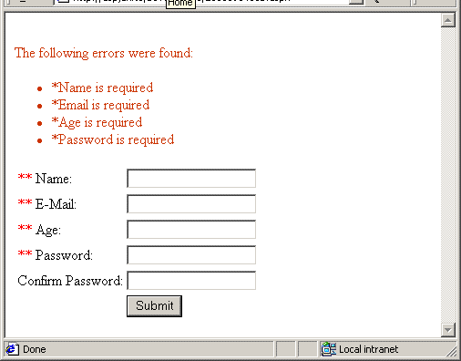
ASP.NET: Validation
A Validation server control is used to validate the data of an input control. If the data does not pass validation, it will display an error message to the user.

Slide 26

Themes & Skins

Slide 27
ASP.NET : Themes
What is a theme?
A theme is a collection of property settings that allow you to define the look of pages and controls, and then apply the look consistently across pages in a Web application, across an entire Web application, or across all Web applications on a server.
A theme contains:
skins,
cascading style sheets (CSS),
images,
and other resources

Slide 28
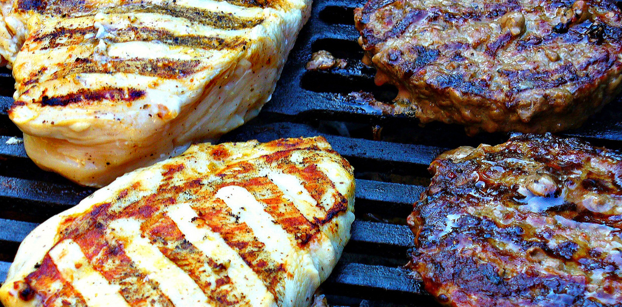
Done

Slide 29
Resources – ASP.NET
Firebug
http://getfirebug.com/
ASP.NET Webforms
http://www.asp.net/web-forms/
ASP.NET MVC
http://www.asp.net/mvc/
Quickstarts
http://quickstarts.asp.net/
Master pages
http://www.asp.net/learn/master-pages/
Profiles, Themes and user controls
http://www.asp.net/learn/moving-to-asp.net-2.0/module-10.aspx
Page lifecycle
http://www.asp.net/learn/videos/video-6558.aspx
Validation
http://quickstarts.asp.net/QuickStartv20/aspnet/doc/validation/default.aspx
ASP.NET AJAX
http://www.asp.net/ajax/

